Slide 1
Coming to a Computing Consensus
Braeden Van Deynze, Christie Bahlai, Chad Zirbel
LTER All Scientists’ Meeting 2018
October 2nd, 2018
Pacific Grove, CA

Slide 2

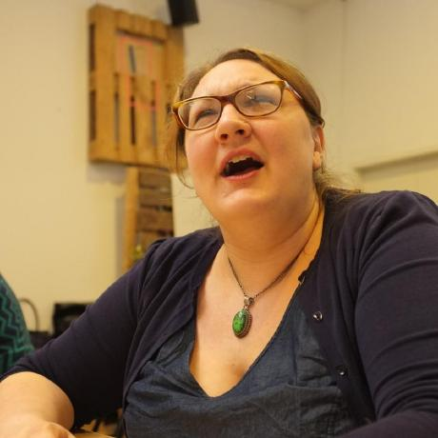
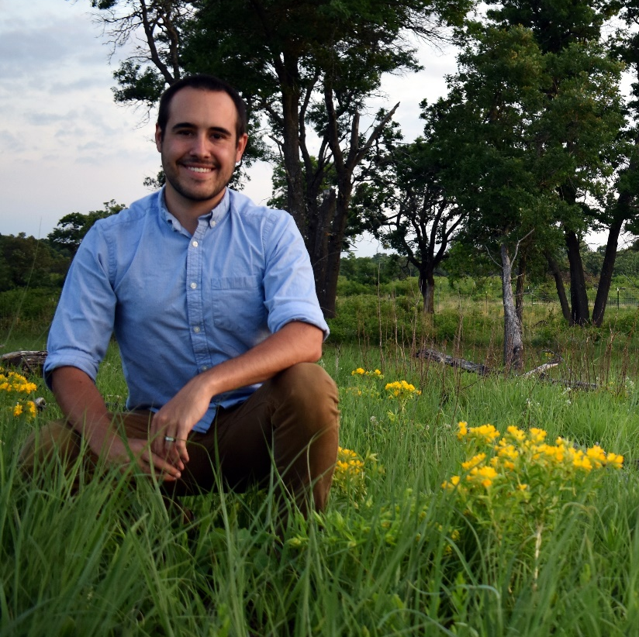
Who We Are
Braeden Van Deynze
Grad Student
Michigan State
Christie Bahlai
Asst. Professor
Kent State
Chad Zirbel
Post Doc
Minnesota

Slide 3
Today’s Outline
Challenges in Collaboration
GitHub: A Web-Based Collaboration Tool
Reflect on Past Collaborations
Develop The N Commandments of Collaborative Computing
Goal: Explore solutions to the challenges of modern, data-intensive collaborative projects over long-distances

Slide 4
Challenges of Collaboration
What conditions are necessary for collaboration?

Slide 5
Challenges of Collaboration
What conditions are necessary for collaboration?
What additional challenges does cross-site LTER research introduce?

Slide 6

GitHub
A Digital Collaboration Tool

Slide 7




20 tasks to do, 3 people working on the project, and no common to-do list
Who is doing what?

Slide 8
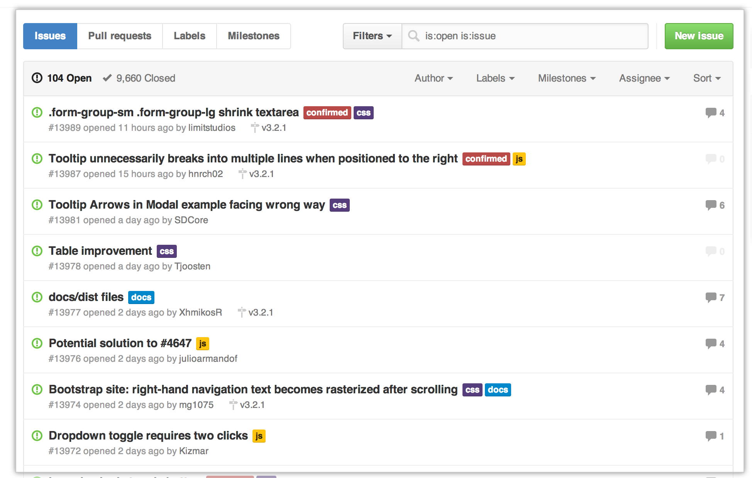
Issues
To-do list for the project
Bugs that need fixing
Tasks needed to be done
Future plans
Can assign issues to collaborators (or yourself)
Can label issues for certain parts of the project

Slide 9
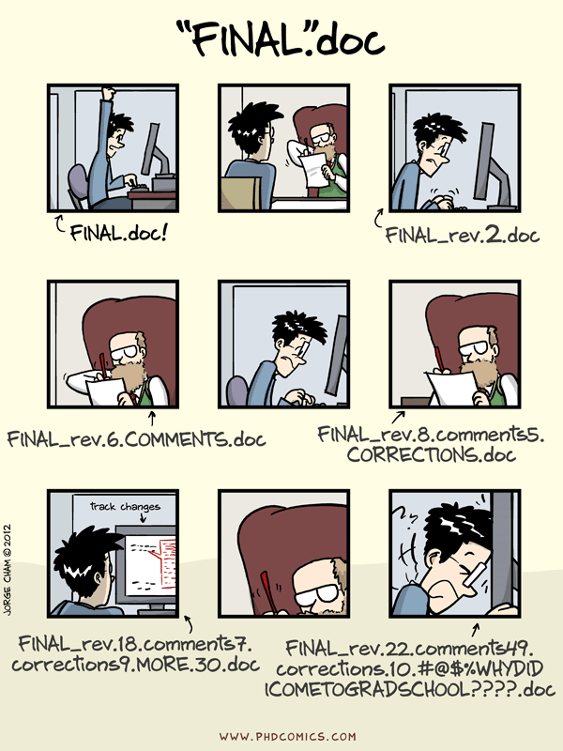
Multiple people working on the same files
The multiple conflicting versions monster

Slide 10
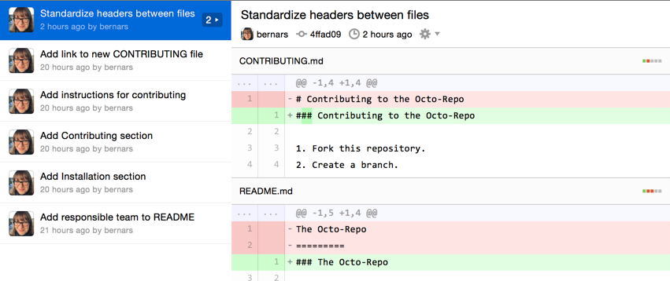
Version control and merge conflict resolution

Slide 11
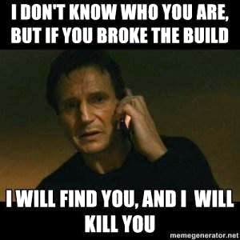
Try something new without messing up your project

Slide 12
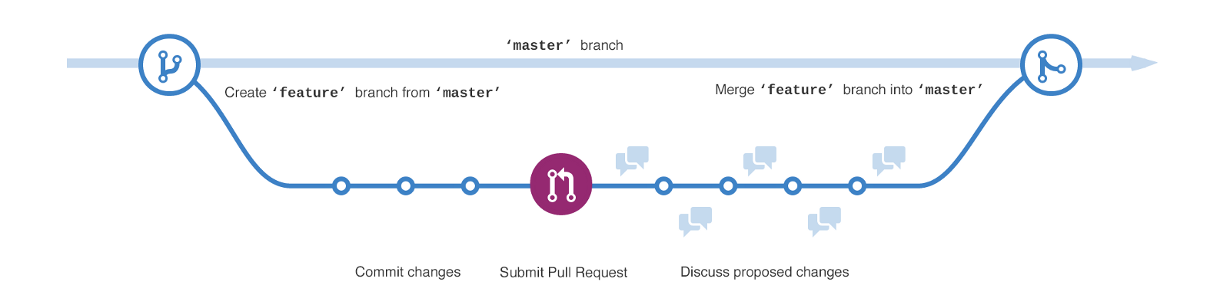
Branch/Merge
Try new things without messing up a project
Make code better without breaking existing code

Slide 13
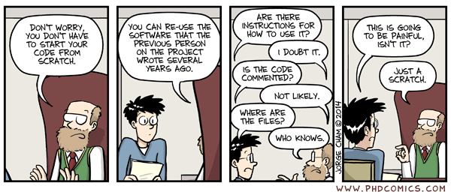
Reproducible research

Slide 14
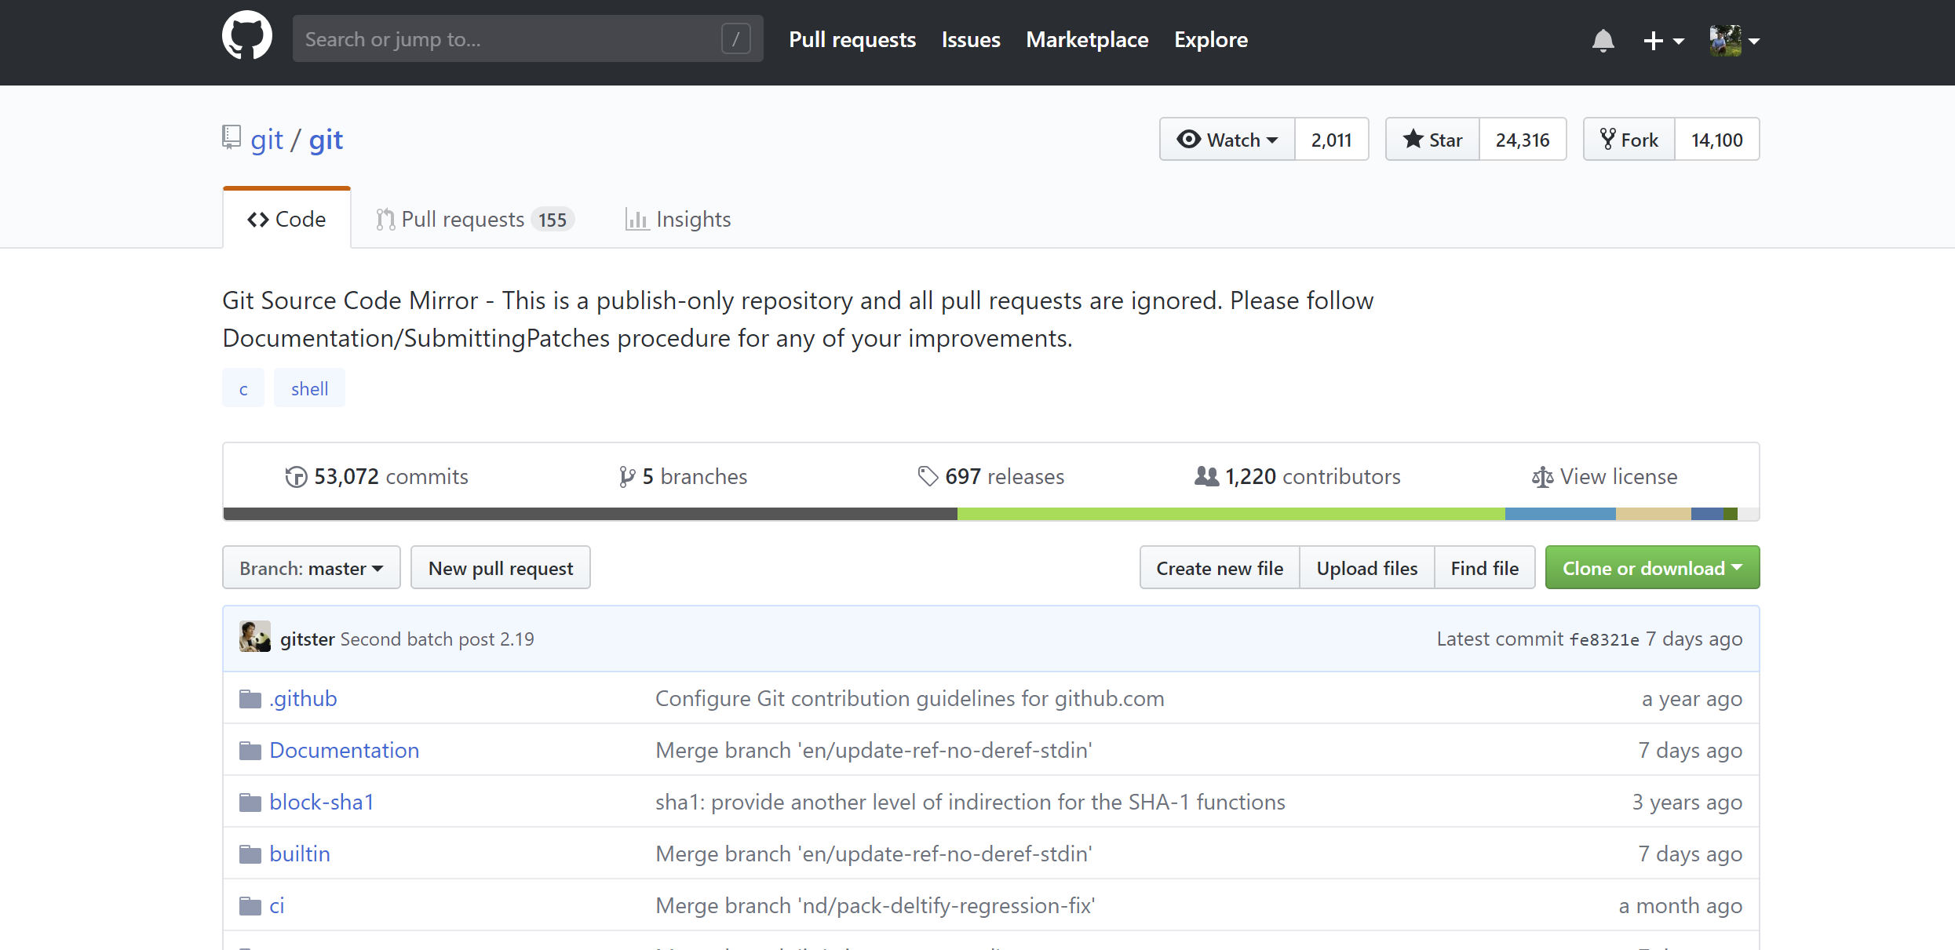
One home for your research project

Slide 15
Small Group Discussions
Learning from Past Collaborations

Slide 16
Small Group Discussions
What you’ll need…
Some people to talk with
Some notetaking technology (e.g., pen and paper, laptop, tablet)
What we’ll do…
Reflect on past collaborative experiences
Gather anecdotal evidence to support The N Commandments of Collaborative Computing
Focus on digital aspects and tools that worked (or not)

Slide 17
Part 1: Introductions
Share…
Institution and LTER site
Role (e.g., professor, postdoc, grad student, etc.)
Research area

Slide 18
Part 2: Reflecting Back
Think…
What was the goal of the project (e.g., a paper, a novel dataset, a grant proposal, an outreach program, etc.)?
How many people were involved? What kind of people (e.g., interdisciplinary, different career stages, different technical expertise, etc.)?
Was the group based in one location? How long did the collaboration last?
Share…
What was the project?
One or two "highlights" – What worked smoothly in this group?
One or two "frustrations" – What could have gone better in this group?

Slide 19
Part 3: Looking Forward
Think…
What tools, resources, or workflows do you consider necessary for a successful collaboration?
What can be done to more easily facilitate the use of these tools throughout a project’s lifecycle?
Share…

Slide 20
Consensus Building
Developing the N Commandments

Slide 21
What Consensus Is
Everyone’s opinions are heard and encouraged
Differences viewed as helpful, chances to learn more
Everyone can understand the result and how it was reached

Slide 22
What Consensus Is Not
Unanimous agreement on end product
Conflict is avoided, ignored
Result is everyone's first choice

Slide 23
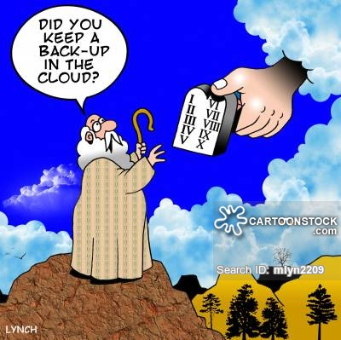
Consensus Process
Stage 1: Share ideas
Stage 2: Review ideas

